Slide 1
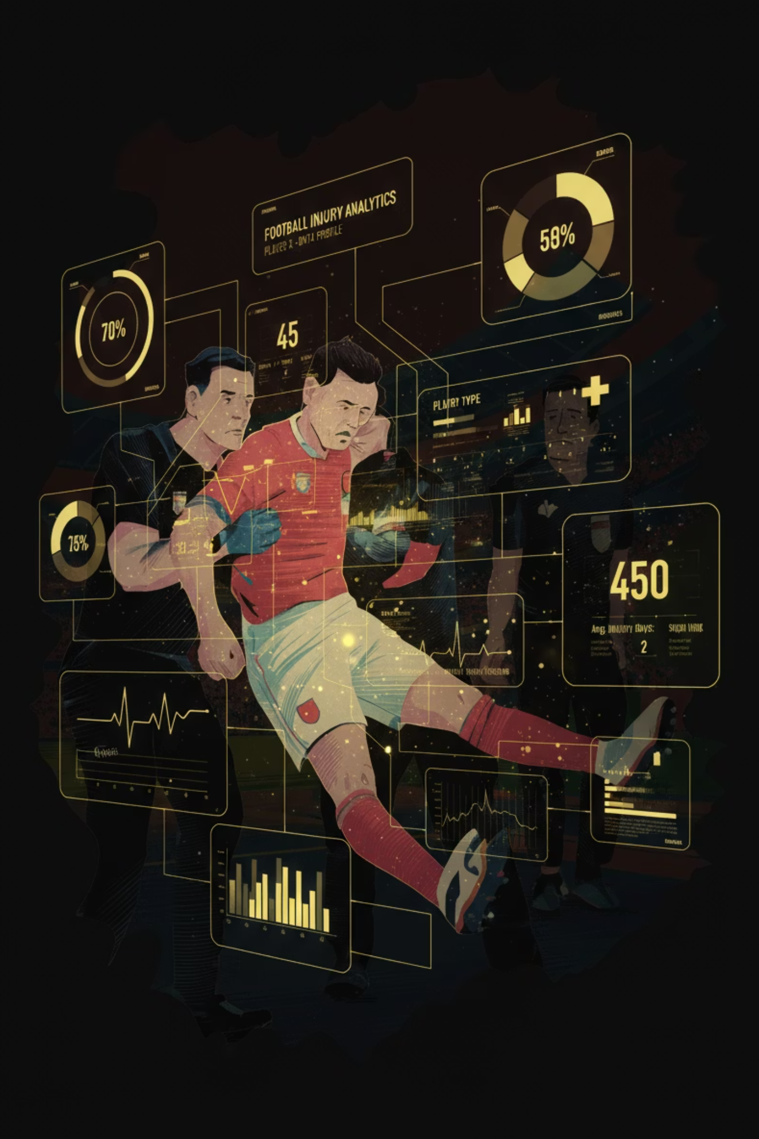
Team: JoblessWinners
Members:
Fnu Abdullah
Syed Furqaan Hussain
Mohammed Aqib
Bareer Ali Khan
ESPN Analytics Dashboard
£420M+ club costs
Tactics & chemistry impacted
InjurySheild

Slide 2

Reactive Decisions
Issues
Workload
Inconsistent tracking.
Screening
Post-injury assessment.
Coaching
Intuition-based rotations.
Opportunity
Predict injury risk: 7-10 days
Physiological signals
Proactive prevention

Slide 3









Fatigue: Not Minutes
Micro-Stress Accumulation
Our Fatigue & Vulnerability Index tracks physiological reality.
Match Load
5-match windows
High-Intensity
Effort Density
Injury History
Previous Trauma
Recovery Gaps
Insufficient Rest
Converts raw stats to stress, revealing burden pre-breakdown.

Slide 4
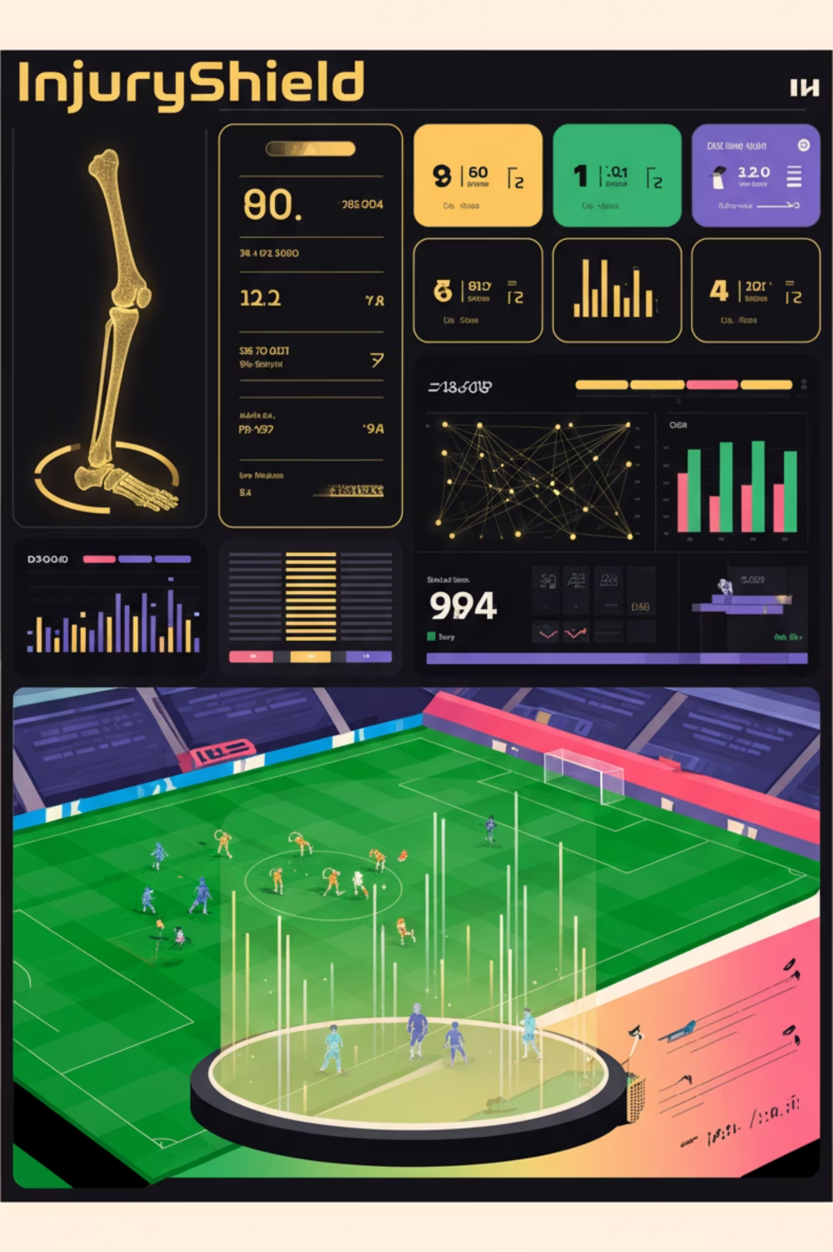

InjuryShield
Predict. Protect. Perform.
ML system.
Predicts risk.
Estimates recovery.
Optimizes rotations.
1
2
Injury Risk
Recovery Time
Probability (0–1). Prevent.
Days out. Manage return.
3
Performance Impact
Form score. Optimize.

Slide 5
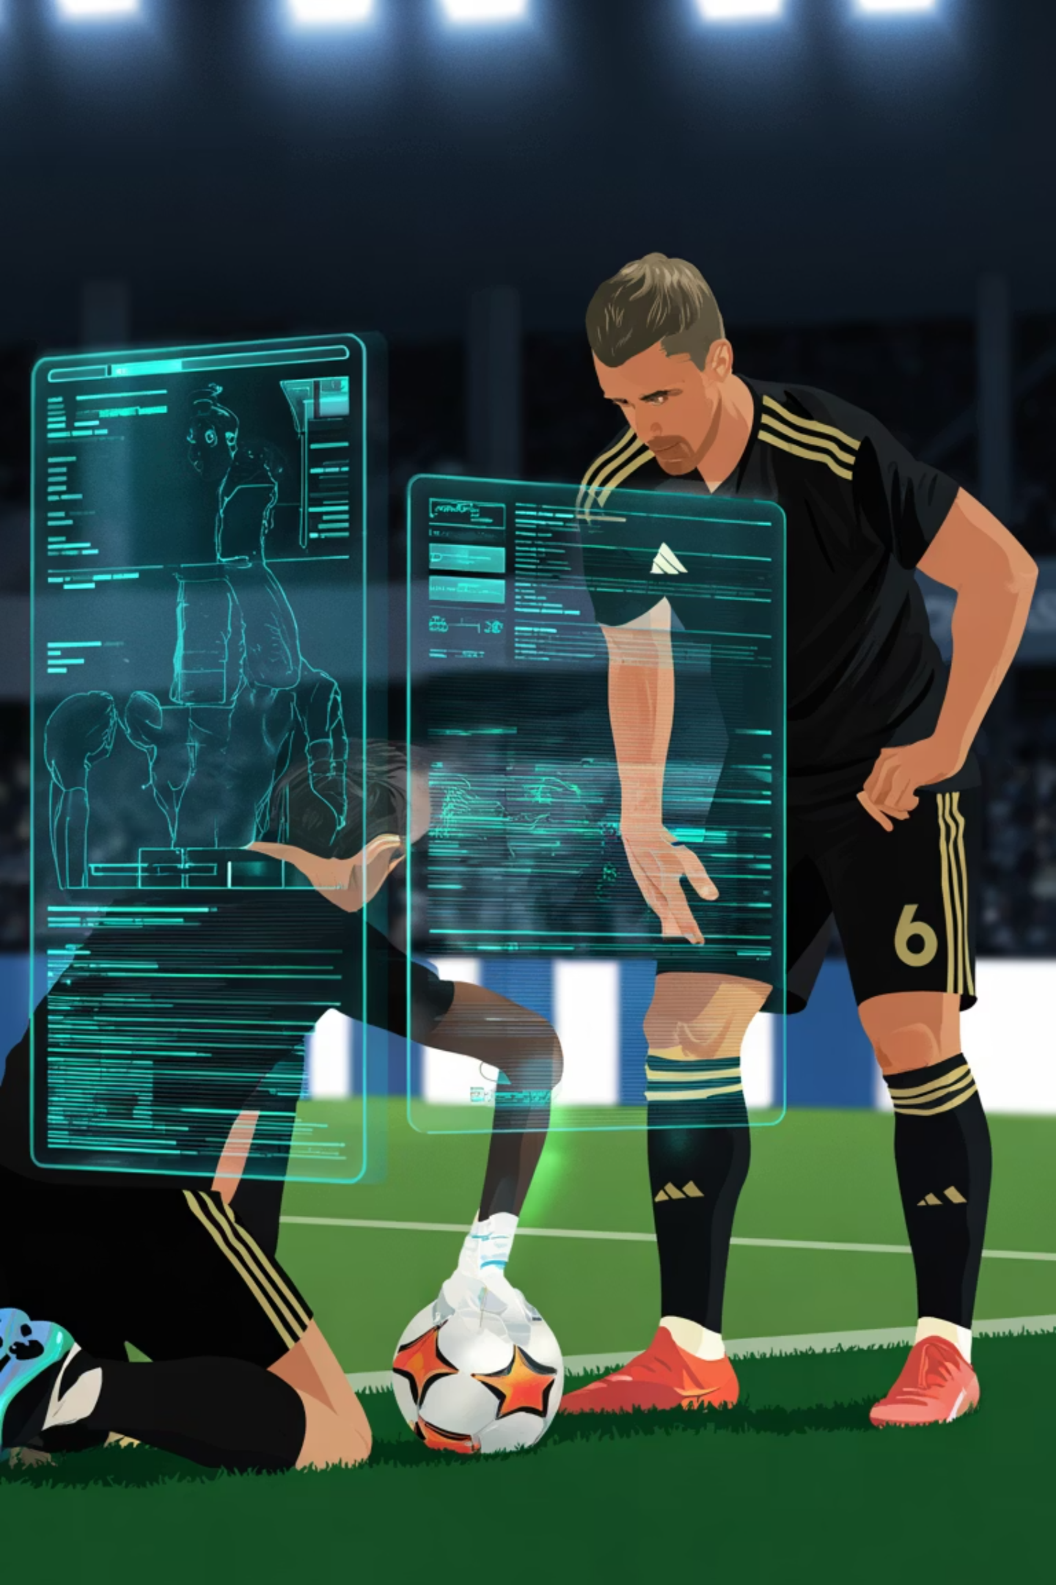
Dataset Used
Source: Kaggle — Player Injuries & Team Performance Dataset
Size: 2,638 player injury cases (2013–2023)
Scope: European professional football clubs
Key Columns Used:
Player Info: Name, Team, Position, Age, FIFA Rating
Injury Details: Injury Type, Date of Injury, Date of Return
Performance Metrics: Match Rating Before vs After injury
Team Impact: Matches Missed, Goal Difference While Absent
Why This Dataset:
Allows us to measure how injuries affect performance
Supports predictive modeling for risk, recovery time, and return impact

Slide 6
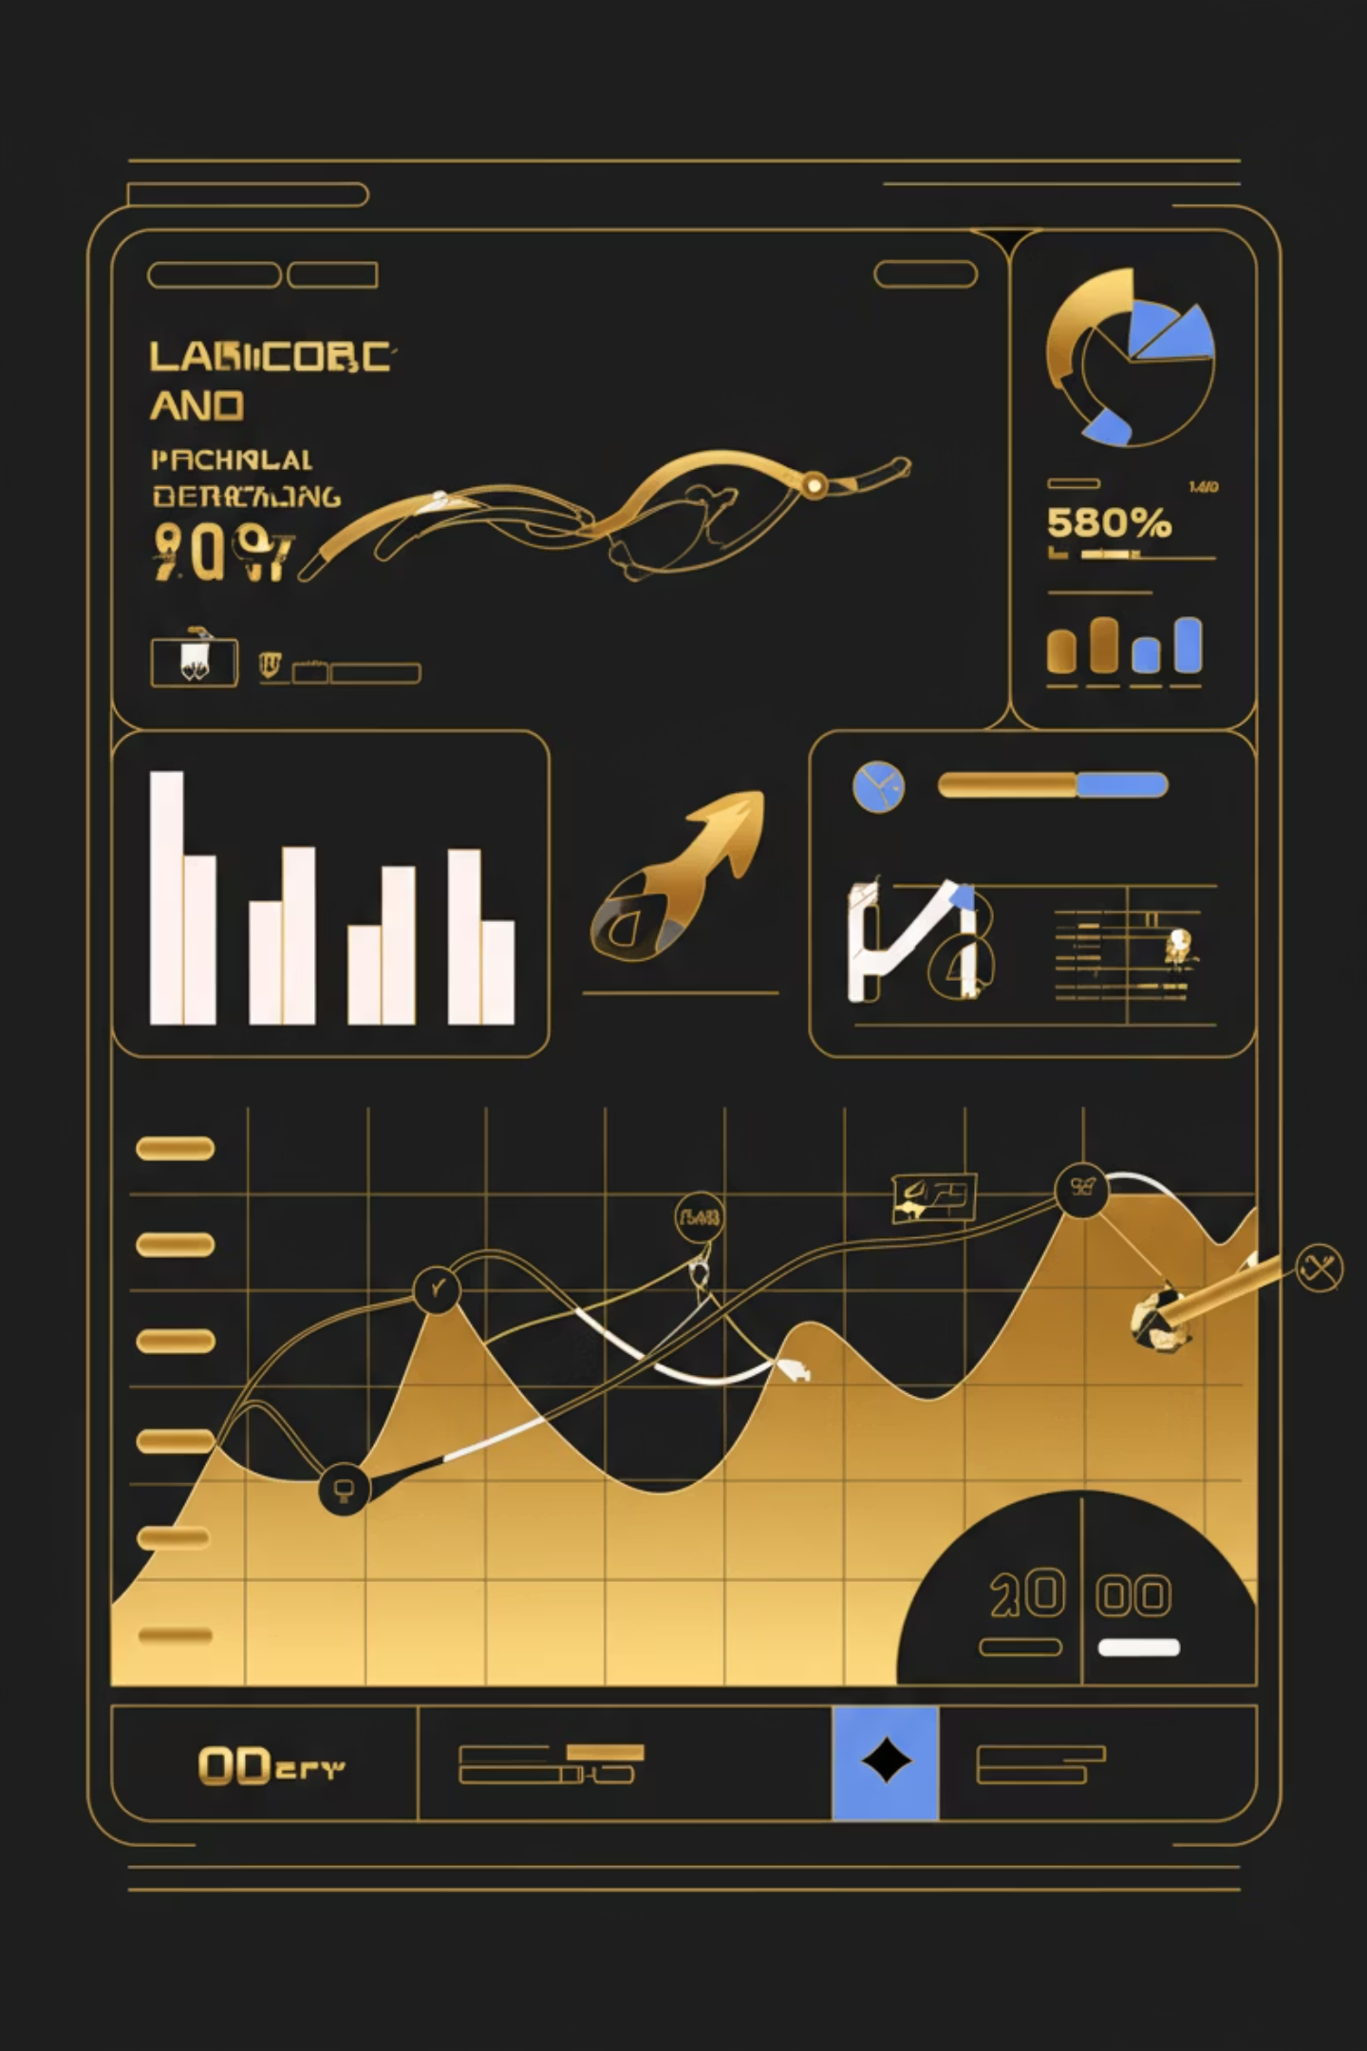
Feature Engineering Performed
We derived additional features to improve model accuracy:
New Feature
Meaning
Recovery Days
Time taken to return (Return Date − Injury Date)
Avg Rating Before Injury
Player's baseline performance
Avg Rating After Injury
Performance post-recovery
Rating Drop (Impact Score)
Performance decline due to injury
Severe Injury Flag (>28 days)
Used as classification target
Why Important:
Helps the model detect performance drop patterns
Enables quantitative injury severity assessment
Supports coaching decisions on substitution & rotation

Slide 7
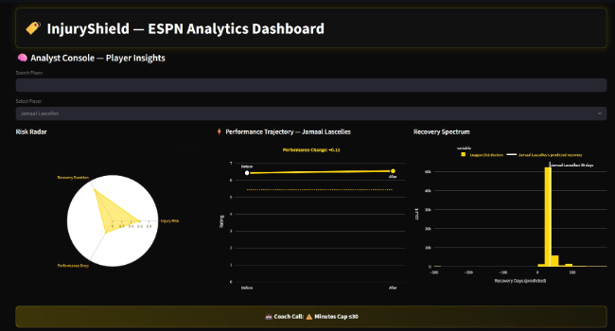
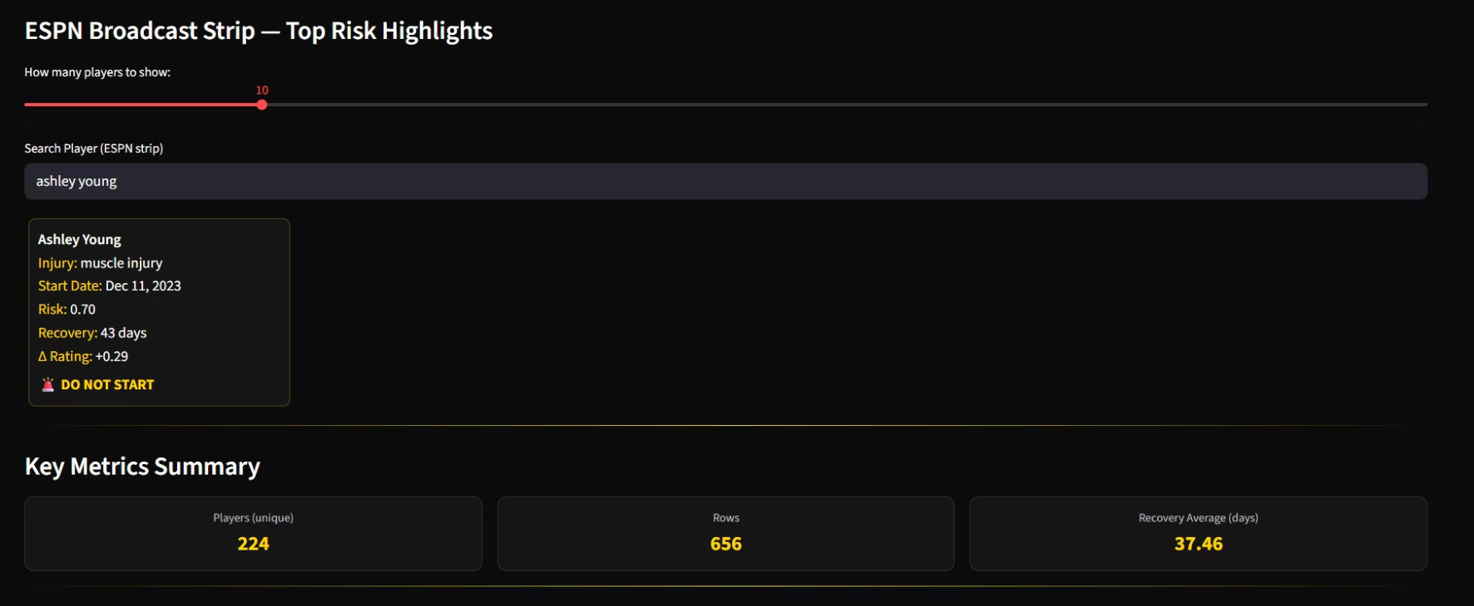
TECHNOLOGY STACK — Elite Performance Analytics Architecture
Data Processing & Feature Engineering
Python (Pandas, NumPy) for structured player injury + performance timeline modeling
Scikit-Learn for grouped cross-validation (ensures no player leakage across folds)
Predictive Modeling
Gradient Boosting Classifier → Severe Injury Risk (% likelihood of re-injury)
Gradient Boosting Regressor → Recovery Time Estimation (days)
Random Forest Regressor → Performance Drop Forecast (match rating impact)
Visualization & Interpretability
Matplotlib & Plotly — Rating curves and recovery slopes
Deployment
Streamlit UI → Real-time Coach Strategy Dashboard

Slide 8
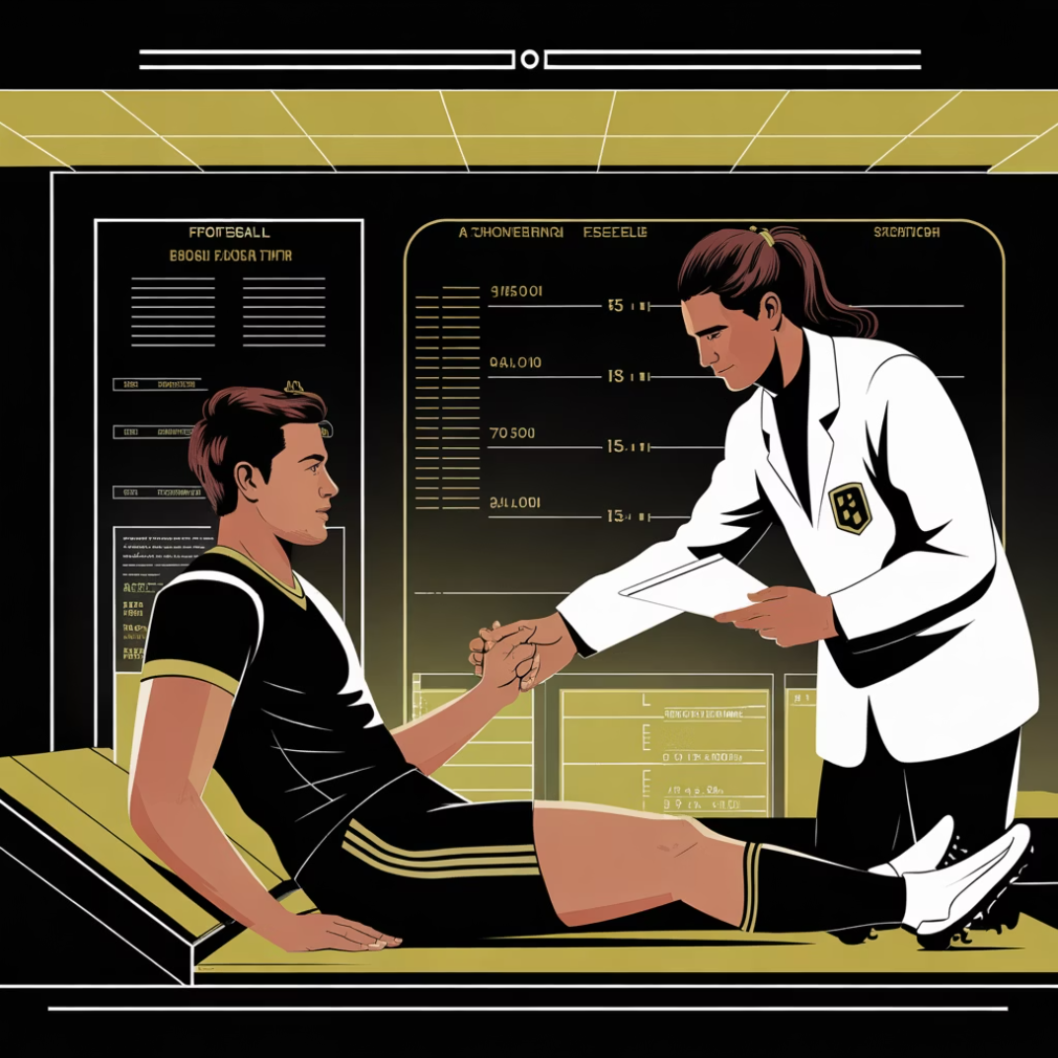
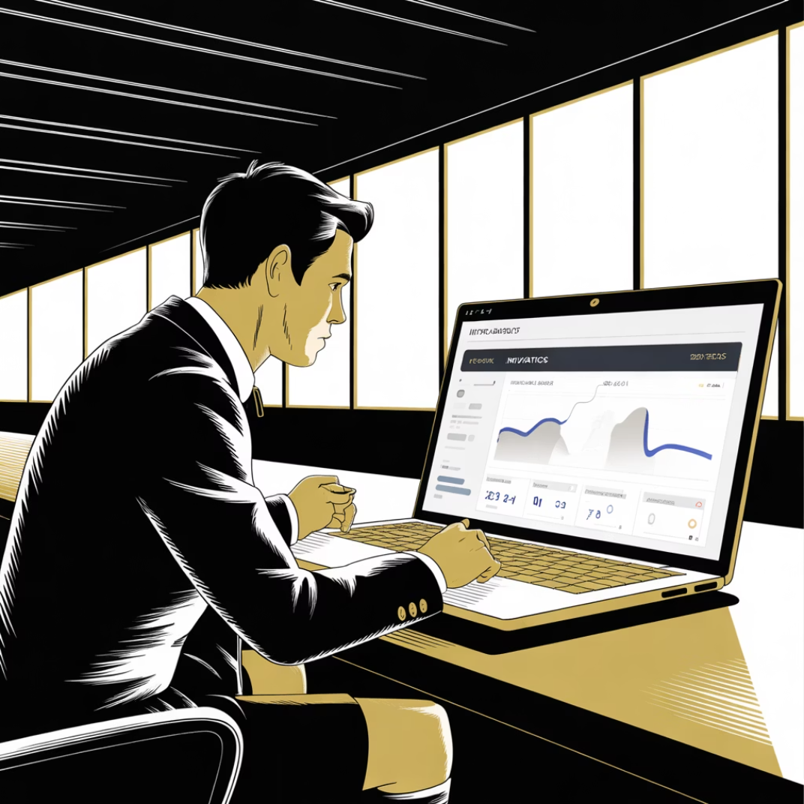
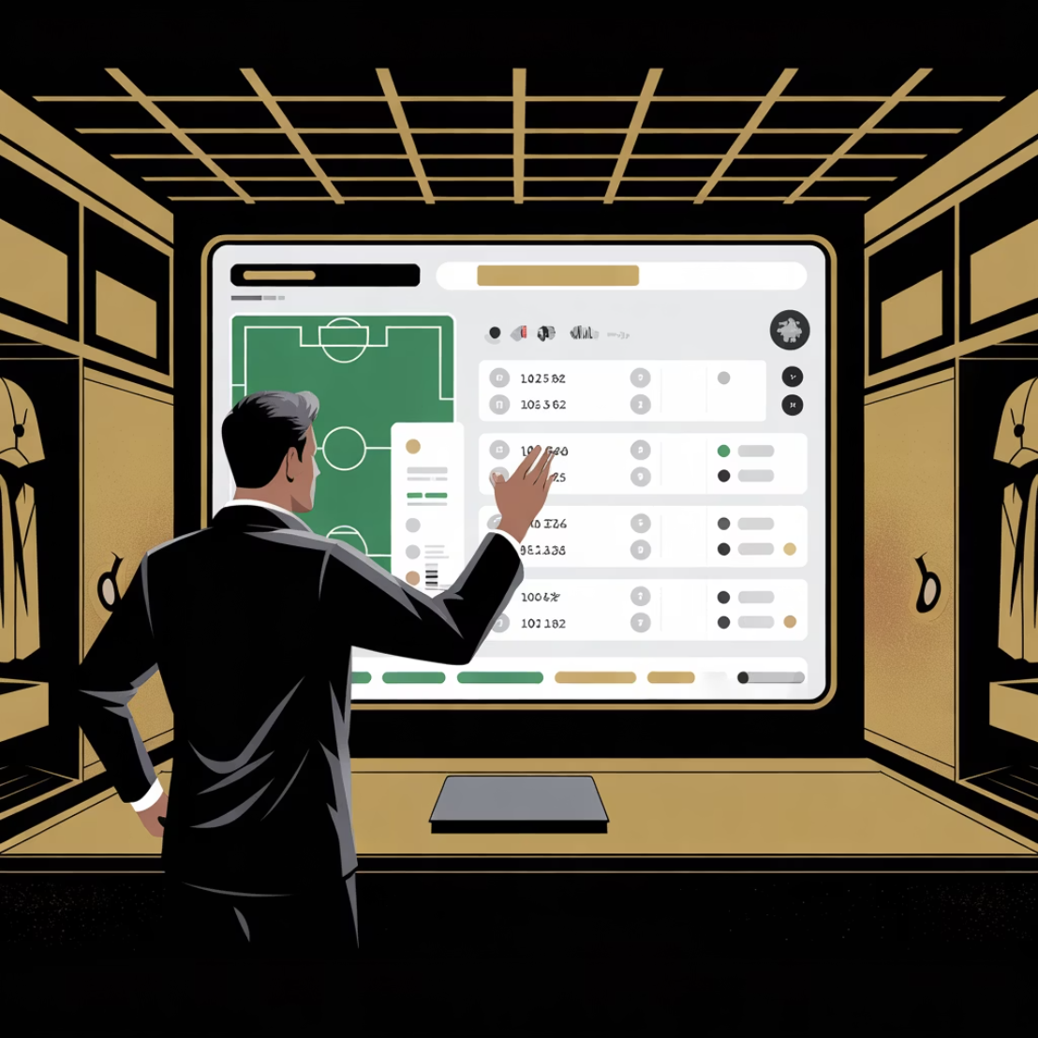
Top Real-World Applications
Return-to-Play Decision Support
Squad Rotation & Lineup Optimization
Transfer & Contract Risk Evaluation
Predicts safe comeback timing to reduce re-injury risk.
Quantifies injury-adjusted player value to avoid costly signings.
Determines who should Start, Rest, or Late-Sub to maintain match performance.
Transforms injury analytics into tactical and financial advantage.

Slide 9

The Real Value
We don't just predict injuries.We prevent bad decisions.
Performance • Health • Strategy

